Slide 1
Assignment 7.1
Clayton Oswald

Slide 2
Project Steps
Created Table in Oracle
Created Web Project with JSP XML and Java Beans
Linked Web Project With Tomcat and Oracle
Ran Project Through Tomcat Server
Localhost 8088
Tested inputs
Screenshot Results

Slide 3
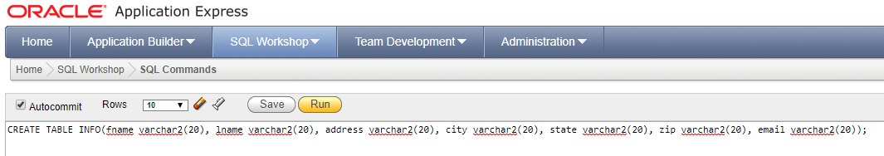
SQL Table
Used Same Table From Assignment 6.1

Slide 4
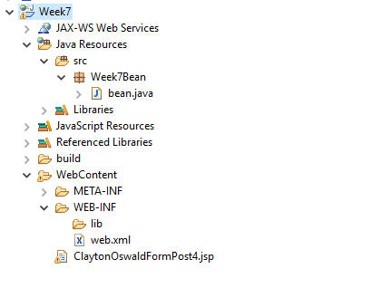
Project Layout
Very Similar to Assignment 6.1
Difference is the bean.java file that contains the new DB connection and the SQL Command

Slide 5
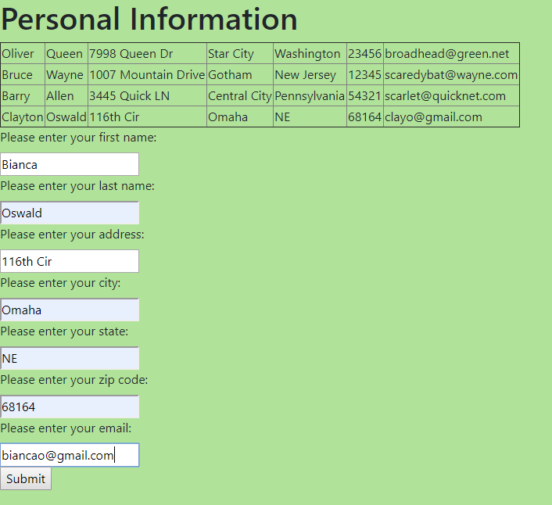
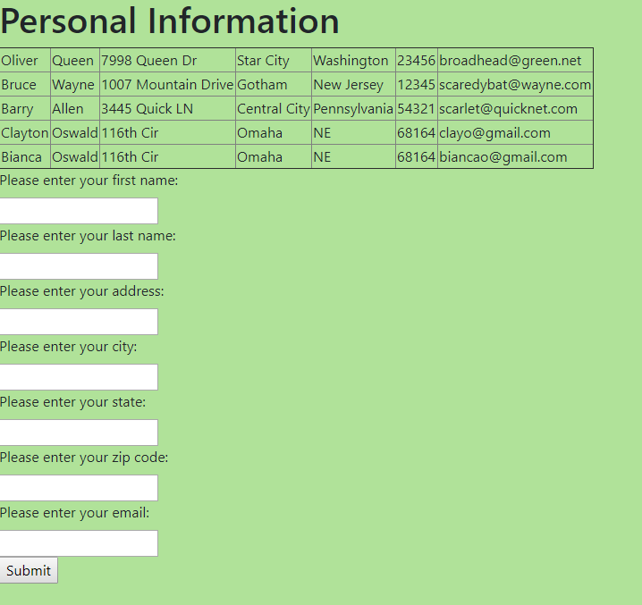
New Table Results

Slide 6

Final Thoughts
Overall, Java Beans wasn’t to complicated with the examples and tutorials we have.
I thought using the method in assignment 6.1 was more efficient.
Java offers several ways for DB Connection.
Configuring tomcat and oracle within an IDE can still cause issues when not done correctly.

